Slide 1
Micro-Credit Defaulter Model
PRESENTED BY
ABHISHEK MISHRA

Slide 2
INTRODUCTION
Microfinance seems like a continuum between pure capitalism and socialism economies.
Many microfinance institutions (MFI), experts and donors are supporting the idea of using mobile financial services (MFS) .
MFS becomes very useful when targeting especially the unbanked poor families living in remote areas with not much sources of income.
In current world scenario microfinance is widely accepted as a poverty-reduction tool, and it represents $70 billion in outstanding loans and a global outreach of 200 million clients.

Slide 3
PROBLEM STATEMENT
In current world scenario the importance of communication in a person life is known to all.
Many users have telecom connections but are unable to even make a call at dire need due to low or insufficient balance
So here our client having fixed wireless telecommunication network trying to introduce services low price in collaboration with a MFI. The low-income group are the main target of this new launch.
We must predict the defaulter or non defaulter.

Slide 4
EXPLORATORY DATA ANALYSIS
The dataset provided has a shape of (209593, 37). Dataset have no null or duplicated values
Here the target or the dependent variable named “Label” have two different distinct values 0 and 1. Where 0 represents the defaulter & 1 represents the non-defaulter category of people.
Most of the columns have unrealistic values. Few have negative values while few have extremely high values
Due restriction the absurd data were removed using proper condition.
After cleaning the shape becomes (189339,33) leading to approximately 9.6% of data.

Slide 5
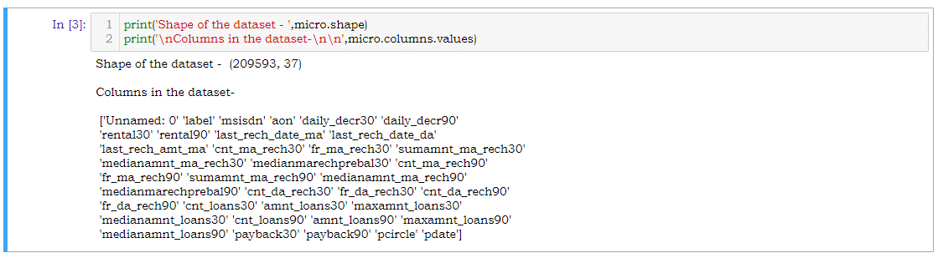

Slide 6
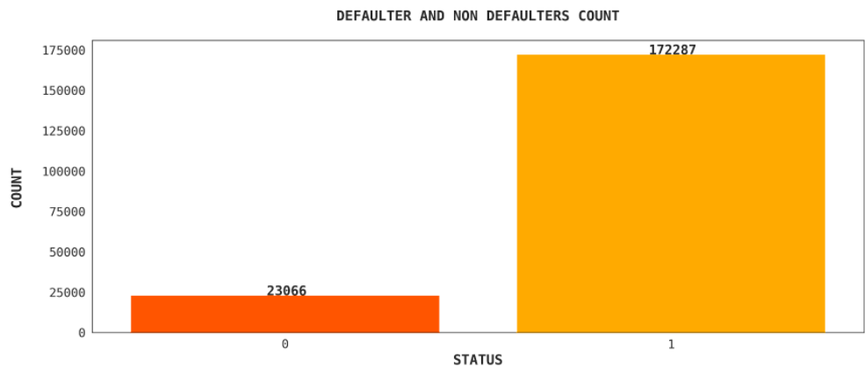

Slide 7
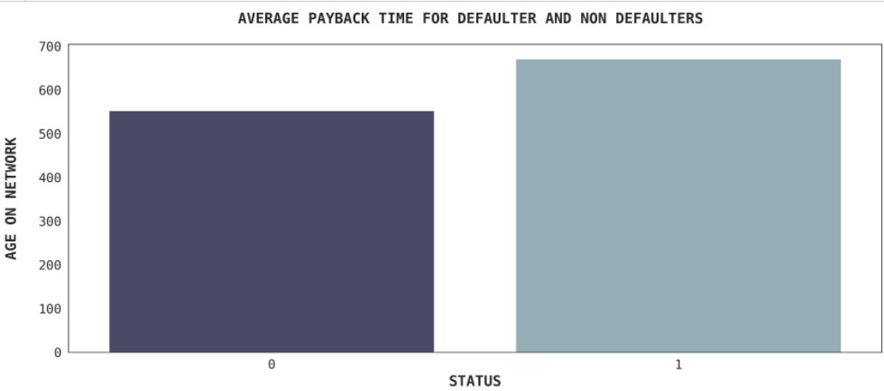

Slide 8
MODELLING
In this classification model algorithms like Logistic Regression, Decision Tree Classifier, Gaussian NB, Random Forest Classifier, XgBoost Classifier were used.
With the help of RandomizedSearchCV hyper parameter tuning will be done and the best parameters for each model will be found.
During modelling various metrices like f1 score, confusion matrix, accuracy score, classification report, roc curve, auc, roc auc score, mean squared error, precision score, recall score will be used to determine the performance of the model.

Slide 9
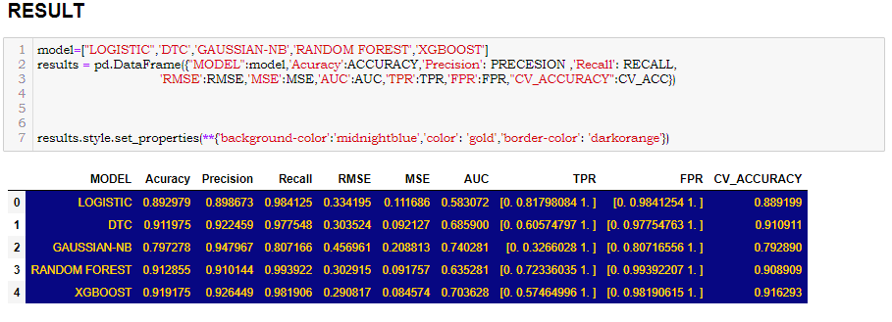
Basing on the result obtained XgBoost Classifier have performed well and has given better result as compared to other models. Here the accuracy score is 91.91%, Precision is 92.64%, AUC value is 70% and after cross validation the accuracy becomes 91.62%. As this model have all the desired characters and performance so XgBoost has been selected as final model and it will be saved using joblib library.

Slide 10
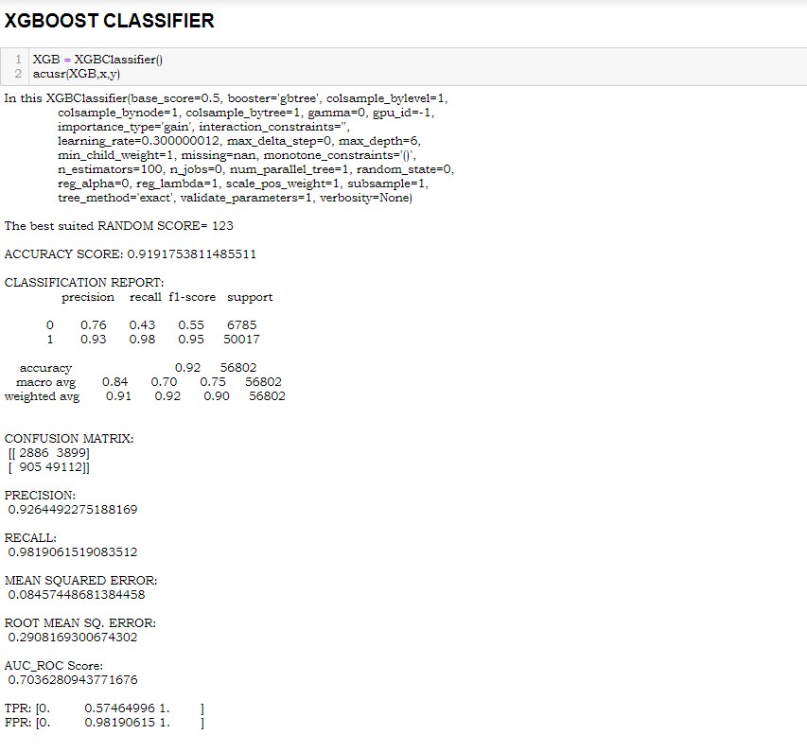
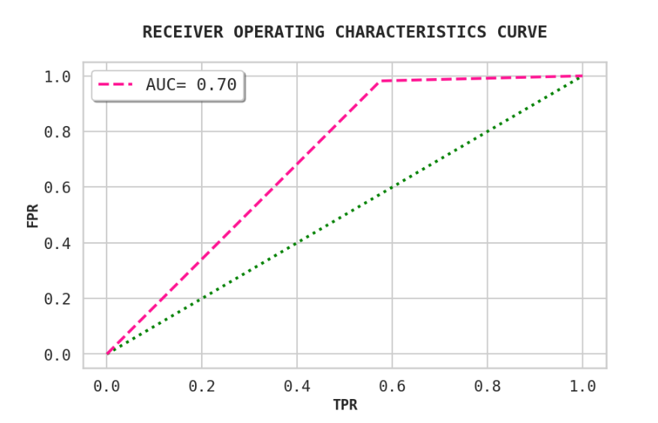
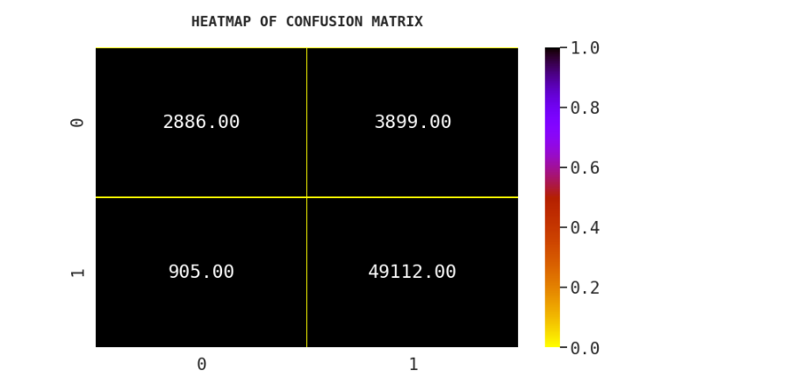

Slide 11
CONCLUSION
From the above analysis the below mentioned results were achieved which depicts the chances and conditions of a user being a defaulter;
Users who are new to the network have a chance of being a defaulter.
Users maintaining a low average of main account balance for last 30 days have a chance of being a defaulter.
Users with low frequency of recharge in last 90 days have a chance of being a defaulter.
Users who have taken low amount of loan in last 30 days have a chance of being a defaulter.

Slide 12
THANK YOU

